Slide 1
TARGETING PASAI’S SP3
Presentation by: Mr. Tiofilusi Tiueti PASAI’s Chief Executive

Slide 2
Strategic Priority 3
Objective A Up to date FGS audited on timely basis
Outcome
To provide government with reliable and accurate information about the financial position of government to make informed decisions for its citizens
Objective B High quality financial audits in accordance with national/international standards
High Quality Audits
completed in a
timely manner
Objective C High quality performance audits
Objective D SAIs audited annually
The focus for this presentation is to get an update on the Status of Financial Statements of Government (FSG) audits in the Pacific

Slide 3
Overview of Presentation - Indicators
O1
| Timeliness
Status as at 30 June 2018
| Audit Opinions
O4
Overview of the audit opinions
O2
| Financial Reporting Frameworks (FRF)
What are the FRF that auditors are working with?
| Auditing Standards
O3
International Standards?

Slide 4
FINANCIAL YEAR ENDS
TOTAL
31 Dec
30 Sept
31 July
30 June
26 SAIs
5 SAIs
10 SAIs
10 SAIs
1 SAI

Slide 5
Timeliness
30 June 2018
69% SAIs
60% Pacific
Number of SAIs who have completed the audit and issued audit opinions
Of the 18, 3 SAIs (Tonga, Samoa and Tuvalu) did not meet the Statutory Deadline.
31% SAIs
40% Pacific
Number of SAIs who have NOT completed an audit of FSG and not yet issued an opinion
Of the 8, (Cook Islands, Fiji, Nauru, Am.Samoa, PNG, Solomon Islands, Tuvalu, Vanuatu) 5 SAIs gave a backlog of more than 2 years
Completed within Statutory timeline
58% 15 SAIs
45% Pacific
Did not complete audit within Statutory timeline
42% 11 SAIs
55% Pacific

Slide 6
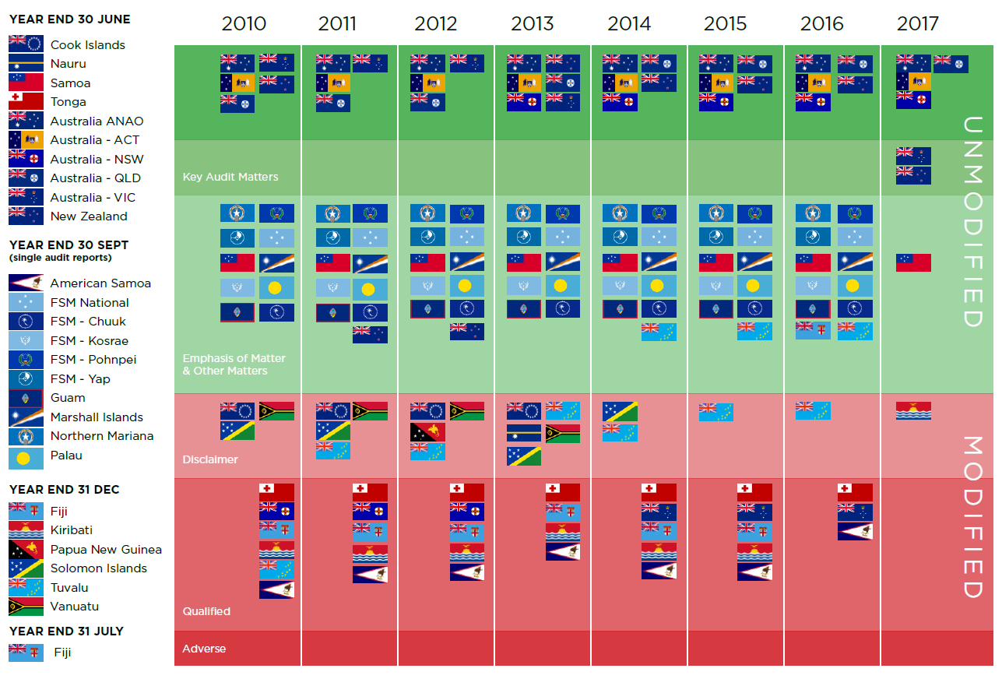
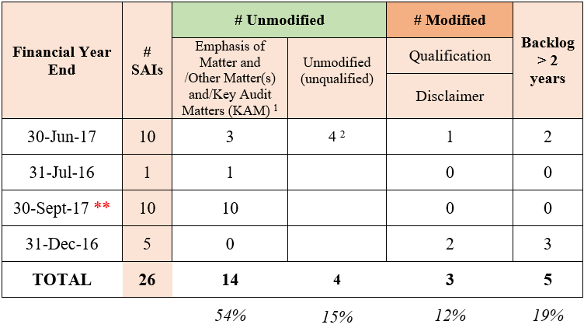
O4
Audit Opinions

Slide 7
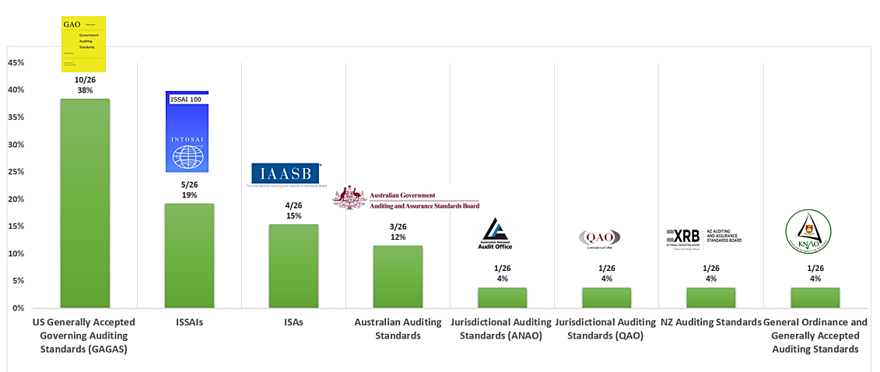
O3
Auditing Standards

Slide 8
Financial Reporting Framework
62% [16/26]
Accrual Basis (US GAAP/GASB)
38% [10/26]
Cash Basis (IPSAS/ GAAP/ Other)

Slide 9
Key Challenges
Capacity
Inexperienced accountants, lack of qualified accountants
Lack of understanding of PFM impacts
Capacity
Quality
Inefficient FMIS, lack of documentation, adequate evidence, knowledge management
Quality
Natural Disasters
Pacific prone to environmental impacts which strike at anytime
Natural Disasters

